Slide 1
Government and National Security
Name

Slide 2
Introduction
There is significant tension between the united states and North Korea over the past decade due to the development of security issues
The government of us have developed essential strategies to prevent North Korea from being a threat to us and its allied nations
The continuous debate on the measures to take have taken place around the world on the best strategies to create peace between these two nations
Notes:
Tension has significantly risen between the United States and North Korea in the past recent two years especially following the successful testing of the intercontinental ballistic missile capabilities in July 2017. The United States government has tried to design strategies that could deter nuclear-armed North Korea to prevent its threat to the U.S and its allied countries. A debate has emerged on what best approach should be adopted by the United States to control North Korea's threat.

Slide 3
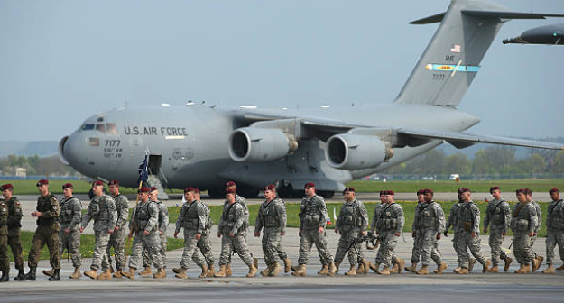
Military option
The use of military option is one of the measures to apply to North Korea to deter them from attacking united states.
The response has been discussed in various platforms such as Congress and stakeholders in the government
However, the dilemma to implement this strategy focus on the consequences to be considered and the threat of tension around the world.
Notes:
Due to the recent test of the intercontinental ballistic missile by North Korea, a critical issue that has emerged in the past months after the 2017 successful test is whether or not the United States would be able to control or deter North Korea if it were to attack the United States. According to McInnis et al. (2017), the United States has considered the military response approach. Through the Congress, the United States, the federal government, has been engaged in
serious strategies to minimize the threats of nuclear-armed North Korea.

Slide 4
Diplomacy Option
This option is another measure considered by the government to pursue negotiations.
It entails the denuclearization of North Korea to resolve the conflict.
The process requires the development of summits to discuss the necessary actions to take.
Notes:
Apart from the military response, the denuclearization of North Korea could be successfullyachieved differently, negotiation. According to Editorial Board (2018), there can be another way to resolve the issue of denuclearization of North Korea. Even though it would be difficult to achieve, a negotiation process is considered to be safe and considerable, especially when conflict is on edge.

Slide 5
Government Involvement
This entails the participation of current administration from each side to explain their responsibilities.
The policies agreed upon should then be implemented to stop the production of some elements such as tritium, uranium, and plutonium
For instance, the development of the meeting between the two government heads was an achievement of the century
Notes:
Since the denuclearization process should be from both sides, the local and state governments should also take part in the process. Both local and State governments should take part in the denuclearization process by implementing the policies made by the Federal government to stop production of the nuclear elements such as plutonium, uranium, and tritium. The most significant responsibility in the denuclearization remains with the Federal government. Editorial Board (2018) explains that the U.S government, under the presidency, has undertaken the first steps towards negotiating with North Korea to reduce the nuclear threats it poses to the United States and its people.

Slide 6
Conclusion
The process of negotiation can sometimes take before it is applied in both the involved nations.
However, as Perkovich (2018) he notes that the ongoing negotiations have to put up with the reality that North Korea may not e able to do away with their nuclear plants.
The determination of possible agreement between the counties can be beneficial to protect and prevent destabilization of America to the exposure of nuclear threats.

Slide 7
References
Berenson, R. (2015). Addressing Pricing Power in Integrated Delivery: The Limits of Antitrust. Journal of Health Politics, Policy and Law, 40 (4), 711-744.
Perkovich, G. (June 04, 2018). “Key Issues for U.S-North Korea Negotiations.” Carnegie Endowment for International Peace

